Slide 1

Extended Detection and Response (XDR)
Ingram Micro CoE Belgrade
Time: ~20 min.

Slide 2
Cyber Security in Digital Edge
Security should be viewed as an element of business management rather than an IT concern.
Security is a journey, not a finish line – continuous improvement
Cybersecurity based on risk-management approach [NIS2 Article 21]
Cyber threat trends:
  Endpoint security,
  Digital identity,
  Cyber sercurity training and awareness,
  Zero trus model,
  Robust cryptography,

Slide 3
Sources
Check Point
Palo Alto
Kaspersky
Fortinet
CrowdStrike
Cisco
YouTube
IBM
https://www.forrester.com/blogs/
Notes:
https://www.forrester.com/blogs/introducing-the-forrester-new-tech-extended-detection-and-response-xdr-a-battle-between-precedent-and-innovation/

Slide 4
Definitions: Extended Detection and Response (XDR)
IDC
  "The most basic definition of XDR is the collecting of telemetry from multiple security tools, the application of analytics to the collected and homogenized data to arrive at a detection of maliciousness, and the response to and remediation of that maliciousness." –IDC, 2023
  Forrester
  The evolution of EDR, which optimizes threat detection, investigation, response, and hunting in real time. XDR unifies security-relevant endpoint detections with telemetry from security and business tools such as network analysis and visibility (NAV), email security, identity and access management, cloud security, and more. It is a cloud-native platform built on big data infrastructure to provide security teams with flexibility, scalability, and opportunities for automation.
  GARTNER
  Extended detection and response (XDR) delivers security incident detection and automated response capabilities for security infrastructure. XDR integrates threat intelligence and telemetry data from multiple sources with security analytics to provide contextualization and correlation of security alerts. XDR must include native sensors and can be delivered on-premises or as a SaaS offering. Typically, it is deployed by organizations with smaller security teams.

Slide 5





Evolution of endpoint protection…
Endpoint Protection (EP)
signature-based detection (malicious files, domains, IP…)
anomaly detection identifies malware based on unusual or malicious functionality
provide tools for incident investigation and response
fileless malware
targeted attack
multi-host kill chain malware attacks
Endpoint Detection and Response (EDR)
use telemetry data collected from endpoints,
behavioral analytics, machine learning & artificial intelligence,
threat intelligence (ASM, VS, 3rd party sources…)
Threat Hunting & Advanced reporting (MITRE ATT&CK™)
Full cyberthreat visibility across your security stack (network, cloud, Email, Endpoint, collaboration …
multi-stage attack
Notes:
EPP is designed to provide device-level protection by identifying malicious files, detecting potentially malicious activity, and providing tools for incident investigation and response
EPP acts as the first line of defense, filtering out attacks that can be detected by the organization’s deployed security solutions
Endpoints Telemetry data:
Processes
Executed commands
Network connections
Files created/accessed
Registry modifications
ATTACK SURFACE MANAGEMENT (ASM)
VULENRABILITY SCANNING (VS)
THIRD PARTY INTELIGENCE SOURCES

Slide 6
Evolution of endpoint protection (EDR - more details)
  Threat intelligence
  machine learning
Threat clud
EDR
  behavioral analytics
Automatic Response
&
Playbooks
  Correlation based on AI
Signature-based detection:
  malicious files,
  malicious domains,
  malicious IP…
Endpoints Telemetry data:
  Processes,
  Executed commands,
  Network connections,
  Files created/accessed,
  Registry modifications.

Slide 7



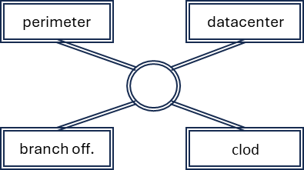

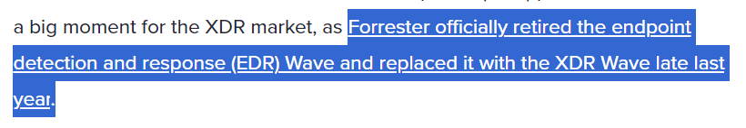



Security Approach with XDR
  Threat Intelligence
  ATTACK SURFACE MANAGEMENT (ASM)
  VULENRABILITY SCANNING (VS)
  THIRD PARTY INTELIGENCE SOURCES
SOC
  CASB & CWPP
Data Enrichment (switch to context),
Use AI tools to corelate data,
Prioritize data in a normalized format through a single console
Multi-stage Threat hunting
Incident Management…
XDR
app sec.
  EP & EDR
  NGFW & NDR
  SIEM & Security tools
Email & collaboration tools
  IAM & PAM
Notes:
Cloud Security • Cloud Access Security Brokers (CASB) • Cloud Workload Protection Platforms (CWPP)

Slide 8
SIEM + SOAR vs XDR
SIEM is primarily a log collection tool to support compliance, data storage and analysis
SIEM does not adequately identify threats without running a separate security analytic module (correlation) on top of a huge data set
SIEM focuses on detecting threats, not responding to them.
SIEM typically relies on rule-based correlation and signature-based detection to identify security incidents vs XDR leverages advanced analytics, machine learning, and threat intelligence to detect sophisticated threats
SIEM's focus is primarily on network-centric log data => Limited endpoint visibility
SOAR incorporates orchestration, automation and response capabilities to the SIEM
XDR is a cloud-native platform built on big data infrastructure (subscription model)
XDR is mostly deployed by organizations with smaller security teams
XDR cannot replace SIEM because the SIEM has use cases outside of threat detection, such as log management, compliance, non-threat related data analysis and management.
XDR is a security solution that is still in its early stages. Many vendors are still working on developing products that work with XDR.

Slide 9
Q & A
Slobodan Milidrag

